Slide 1

Matamata Airfield
Local Area Procedures
Notes:
Busy airfield – many types of aviation

Slide 2
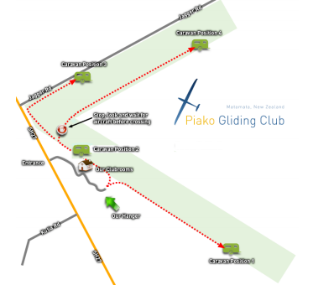
Ground operations
Notes:
Flashing lights
Vacate as soon as possible
Park downwind of caravan
Move around ends of runway – cross only when clear

Slide 3

skydiving
Notes:
Set out coned of Parachute landing area – do not drive through
Jump aircraft calls 3 minutes and 10 seconds prior to drop
Land or fly away from drop zone when the 3minute call given

Slide 4
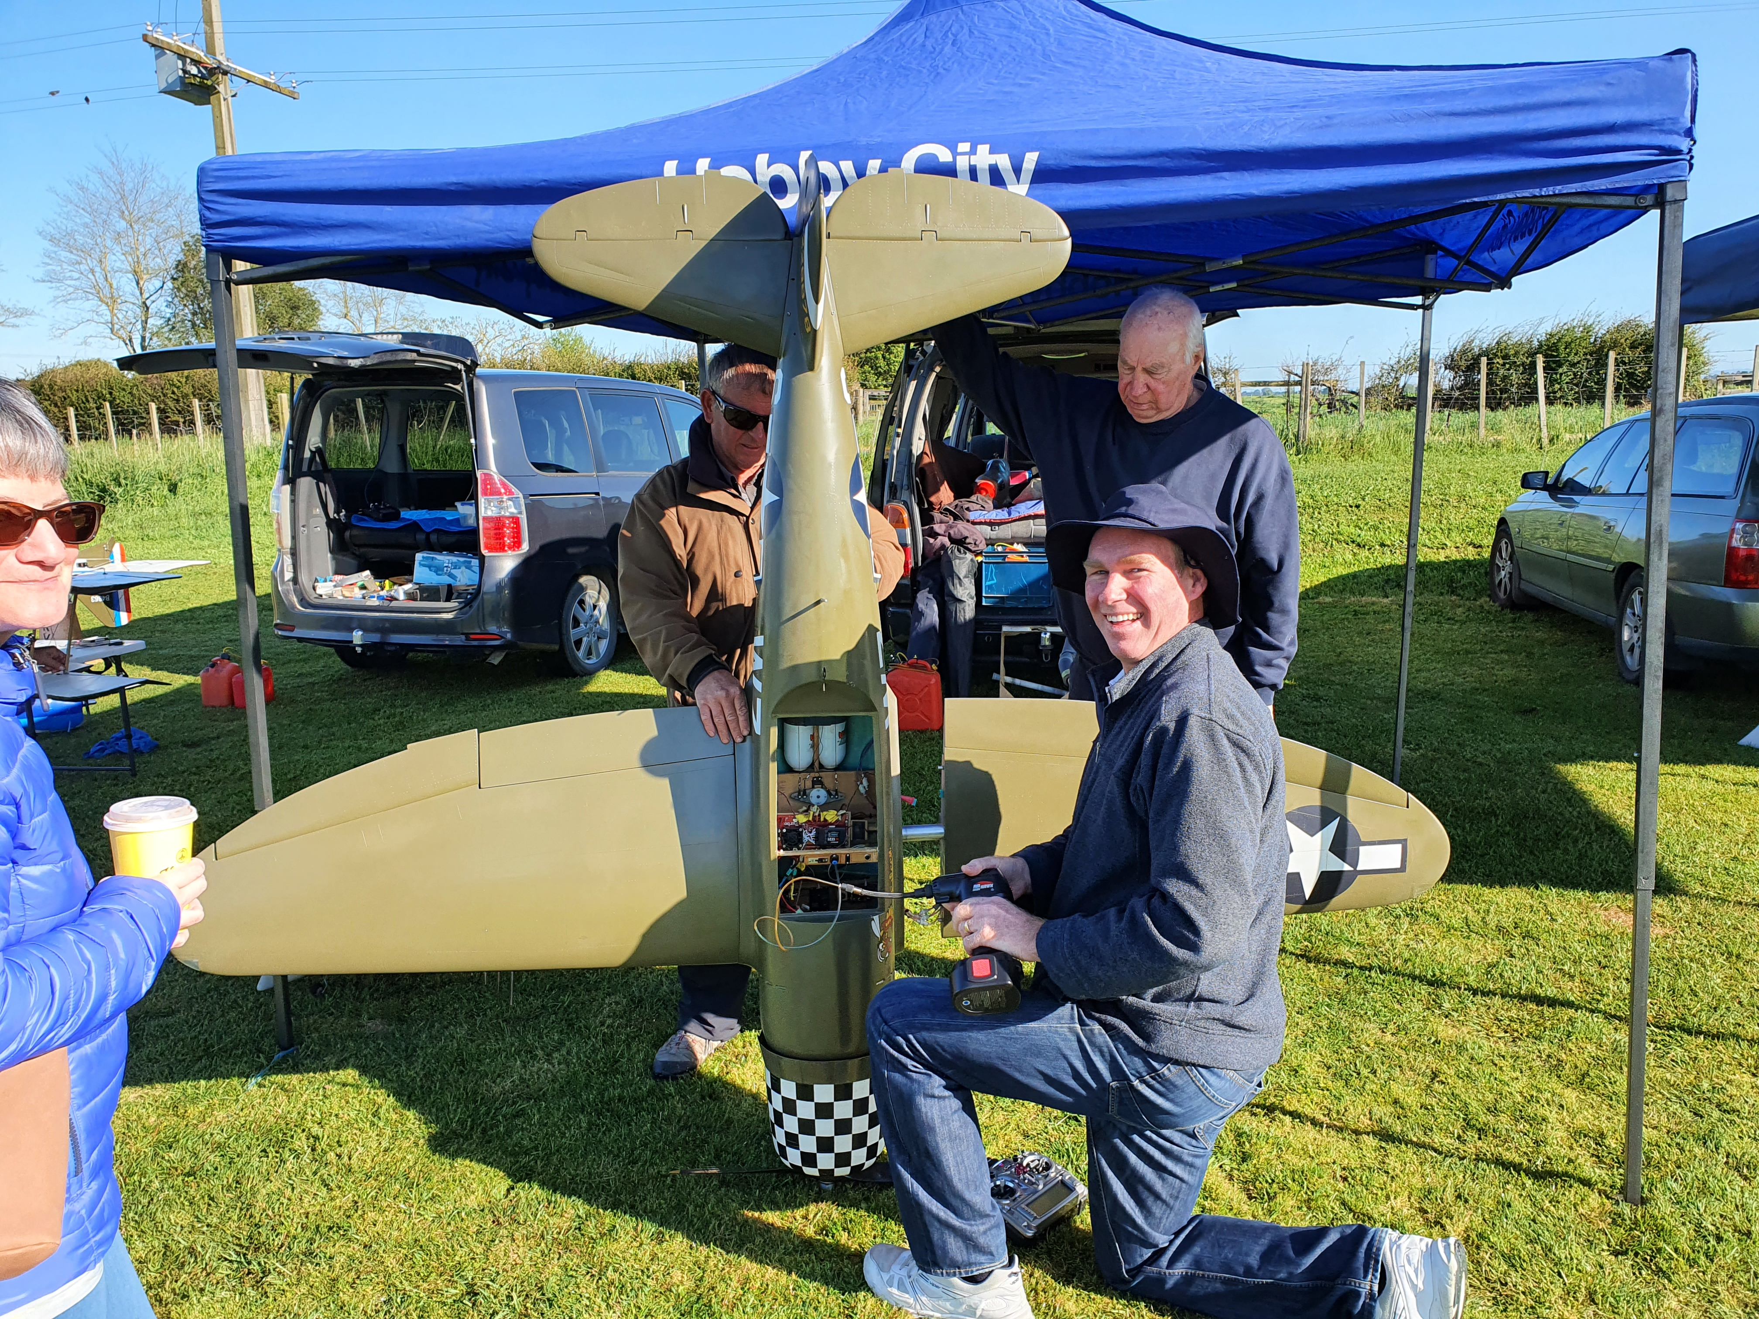
Models
Notes:
Fly on closed runway – marked with crosses
Fly up to 1100 ft
Modellers maintain a listening watch on radio
Avoid area of close-cropped grass on Runway 04/22

Slide 5
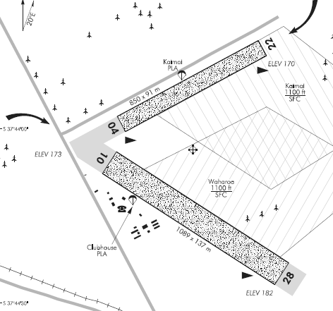
Circuit
Notes:
Circuits for 10/28 S of the runway
Circuits for 04/22 NW of runway
All aircraft use the same circuit – may join from any direction
Powered aircraft circuit may be much bigger than glider circuit
Avoid overhead re-join when winching or parachutes operating
All turns in the circuit direction – NO NOT fly in wrong direction near the circuit
Plan flight to return with enough height for standard circuit
Thermal in circuit area only if you are sure there are no other aircraft or parachutes – immediately land or vacate the circuit area of any one else comes along

Slide 6
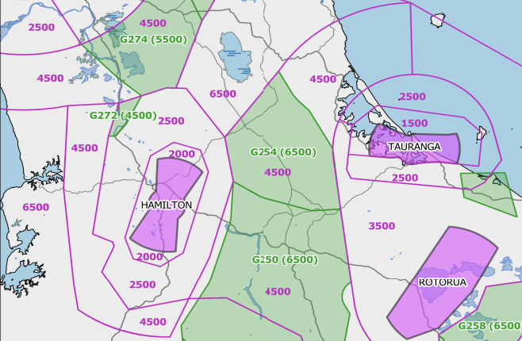
Airspace
Notes:
4500 at Matamata
Can be raised to 6500 ft by contacting ATC to open G254 Matamata

Slide 7
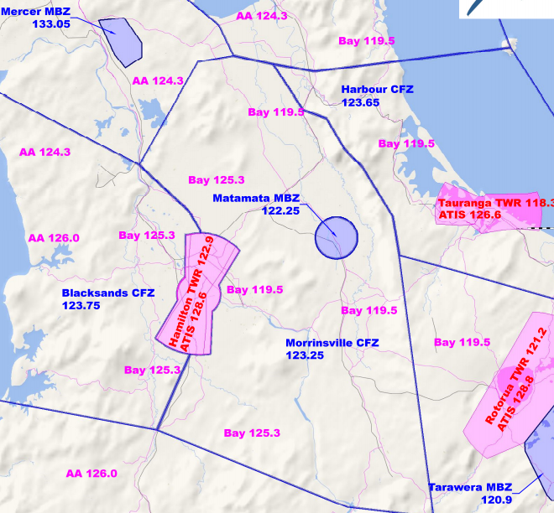
Radio
Notes:
MBZ 3nm radius -
Freq 122.25 Mhz
Radio calls to Matamata Traffic when entering the MBZ, circuit and landing calls, every 15 minutes
Glider chat on 133.55 MHz outside MBZ
Other aircraft on CFZ freqs – monitor in high traffic areas or near airfields
CFZ frequency for unattended airfields within CFZ, e.g. Thames, Tokoroa, Raglan

Slide 8
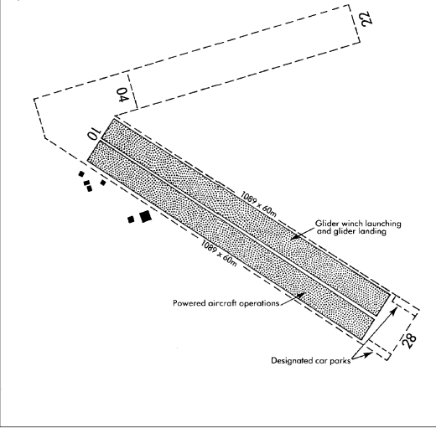
winching
Notes:
Winching on Kaimai side of Runway 10/28
Powered aircraft on southern side
Gliders can use southern side, but remove immediately after landing roll

